Slide 1
Storage on AWS
Brian Fanning – bfannin@amazon.com
Ricardo Peters – ricapete@amazon.com

Slide 2
Agenda
Introduction
Storage Primer
Block Storage
Shared File Systems
Object Store
Notes:
Overview of session

Slide 3
Introduction: Why choose AWS for storage
Compelling Economics
Speed, Agility, Scale
Easy to Use
Reduce risk
Pay as you go
No risky capacity planning
No need to provision for redundancy or overhead
Self service administration
SDKs for simple integration
No Commitment
Durable and Secure
Avoid risks of physical media handling
Reduce time to market
Focus on your business, not your infrastructure

Slide 4
0
Storage Primer

Slide 5
Block vs File vs Object
Block Storage
Raw Storage
Data organized as an array of unrelated blocks
Host File System places data on disk
e.g.: Microsoft NTFS, Unix ZFS
File Storage
Unrelated data blocks managed by a file (serving) system
Native file system places data on disk
Object Storage
Stores Virtual containers that encapsulate the data, data attributes, metadata and Object IDs
API Access to data
Metadata Driven, Policy-based, etc
Notes:
Each storage option has a unique combination of performance, durability, cost, and interface

Slide 6
Storage - Characteristics
Some of the ways we look at storage
Durability | Availability | Security | Cost | Scalability | Performance | Integration
Measure of expected data loss | Measure of expected downtime | Security measures for at-rest and in-transit data | Amount per storage unit, e.g. $ / GB | Upward flexibility, storage size, number of users | Performance metrics (bandwidth | Ability to interact via API or with other services
Notes:
Each storage option has a unique combination of performance, durability, cost, and interface

Slide 7







Understanding Durability
Standard
IA
Glacier
Two copies on one site
Copies on two sites
copies in three AZ
designed for 99.99% durability
designed for
99.999% durability
designed for 99.999999999% durability

Slide 8
AVAILABILITY VS. DURABILITY
% | Availability | Durability
99.999 | 5 minutes 15 seconds | 1 in 100,000
99.9999 | 31 seconds | 1 in 1,000,000
99.99999 | 3 seconds | 1 in 10,000,000
99.999999999 | 300 uSeconds | 1 in 100,000,000,000

Slide 9
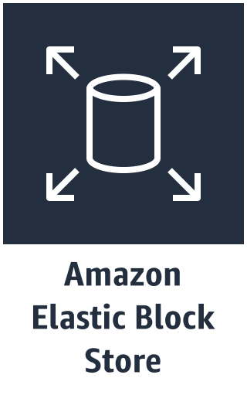
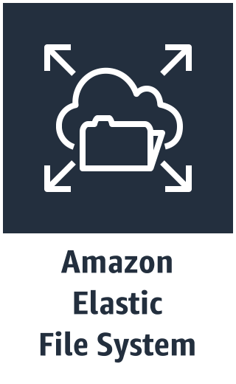



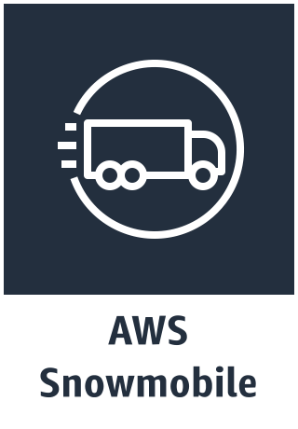

AWS has a variety of storage options
Notes:
Each storage option has a unique combination of performance, durability, cost, and interface.
AWS SNOWBALL is a petabyte-scale data transport solution that uses secure appliances to transfer large amounts of data into and out of the AWS cloud. Using Snowball addresses common challenges with large-scale data transfers including high network costs, long transfer times, and security concerns. Transferring data with Snowball is simple, fast, secure, and can be as little as one-fifth the cost of high-speed Internet.
AWS SNOWMOBILE is NEW and its a secure, Exabyte-scale data transfer service used to transfer large amounts of data into and out of AWS. Each Snowmobile can transfer up to 100PB. When you order a Snowmobile it comes to your site and AWS personnel connect a removable, high-speed network switch from Snowmobile to your local network. This makes Snowmobile appear as a network attached data store. Once it is connected, secure, high-speed data transfer begins. After your data is transferred to Snowmobile, it is driven back to AWS where the data is loaded into the AWS service you select, including S3, Glacier, Redshift and others. It allows customers with large amounts of data to migrate to AWS much faster and easier.

Slide 10
1
Block Storage

Slide 11


What is Amazon EBS?
Block storage as a service
Create, attach volumes through an API
Service accessed over the network
EC2 instance
EBS volume

Slide 12

What is Amazon EBS?
Block storage as a service
Create, attach volumes through an API
Service accessed over the network
EC2 instance
!=
EBS volume

Slide 13
AWS EBS Features
Durable
Secure
Scalable
Designed for 99.999 reliability
Redundant storage across multiple devices within an AZ
Identity and Access Policies
Encryption
Capacity when you need it
Easily scale up and down
Performance
Backup
Low-latency SSD
Consistent I/O Performance
Stripe multiple volumes for higher I/O performance
Point-in-time Snapshots
Copy snapshots across AZ and Regions
Notes:
Amazon Web Services give you reliable, durable backup storage without the up-front capital expenditures and complex capacity-planning burden of on-premises storage. Amazon storage services remove the need for complex and time-consuming capacity planning, ongoing negotiations with multiple hardware and software vendors, specialized training, and maintenance of offsite facilities or transportation of storage media to third party offsite locations.
EBS has 99.99% SLA
See https://aws.amazon.com/about-aws/whats-new/2017/11/announcing-an-increased-monthly-service-commitment-for-amazon-ec2/ & https://aws.amazon.com/compute/sla/

Slide 14
Amazon EBS
Network attached block device
Independent data lifecycle
Multiple volumes per EC2 instance
Only one EC2 instance at a time per volume
Can be detached from an instance and attached to a different one
Raw block devices
Unformatted block devices
Ideal for databases, filesystems
Multiple Drive Types
SSD (iops) and Magnetic (throughput)
Notes:
Network device
Data lifecycle is independent from EC2 instance lifecycle
Each volume is like a hard drive on a physical server
Attach multiple volumes to an EC2 instance, but only one EC2 instance per volume
POSIX-compliant file systems
Virtual disk ideal for: OS boot device; file systems
Raw block devices
Ideal for Databases (Oracle Active Storage Manager)
Other raw block devices

Slide 15






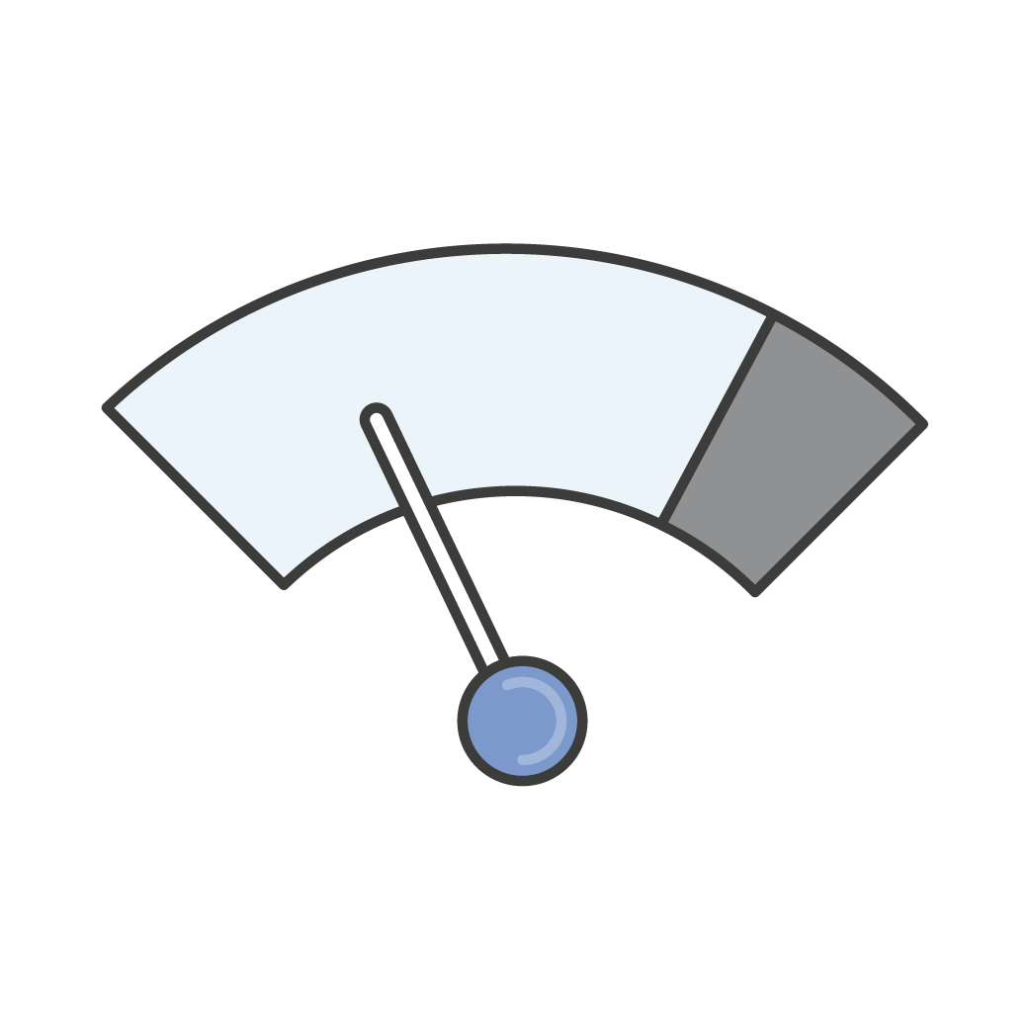
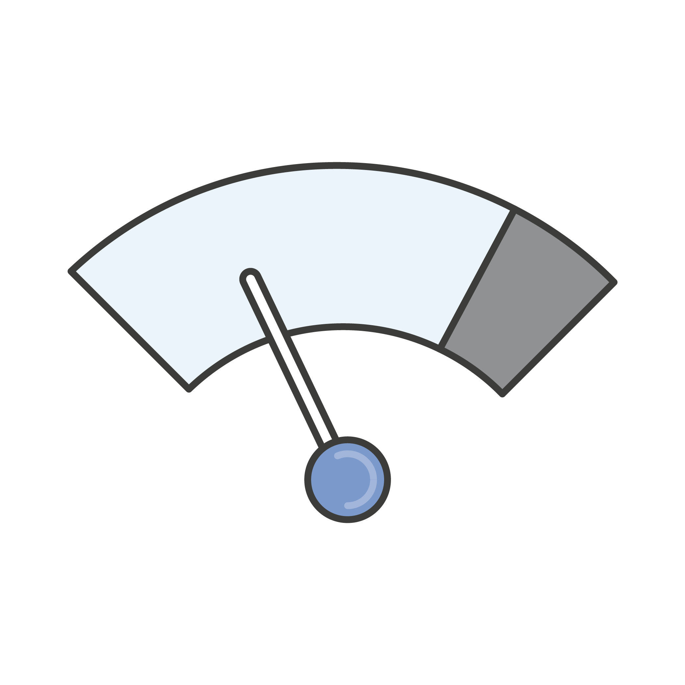

Amazon EBS volume types
SSD
HDD
gp2
io1
st1
sc1
General Purpose
SSD
Provisioned IOPS
SSD
Throughput Optimized HDD
Cold HDD

Slide 16



Amazon EBS use cases
SSD
HDD
Relational Databases
MySQL, SQL Server, PostgreSQL, SAP, Oracle
NoSQL Databases
Cassandra, MongoDB, CouchDB
Big Data , Analytics
Kafka, Splunk, Hadoop, Data Warehousing
File / Media
CIFS/NFS, Transcoding, Encoding, Rendering

Slide 17
Amazon EBS volume types: General Purpose SSD
NEW
Baseline: 100 to 16,000 IOPS; 3 IOPS per GiB
Burst: 3,000 IOPS (for volumes up to 1,000 GiB)
Throughput: Up to 250 MiB/s
gp2
Latency: Single-digit ms
General Purpose SSD
Capacity: 1 GiB to 16 TiB
Great for boot volumes, low-latency applications, and bursty databases
Notes:
I/O size is capped at 256 KiB for SSD volumes and 1,024 KiB for HDD

Slide 18
Amazon EBS volume types: Provisioned IOPS
NEW
Baseline: 100–64,000 IOPS
Throughput: Up to 1,000 MiB/s
Latency: Single-digit ms
io1
Capacity: 4 GiB to 16 TiB
Provisioned IOPS
Ideal for critical applications and databases with sustained IOPS
Notes:
I/O size is capped at 256 KiB for SSD volumes and 1,024 KiB for HDD

Slide 19
Amazon EBS volume types: Throughput Provisioned
Baseline: 40 MiB/s per TiB up to 500 MiB/s
Burst: 250 MiB/s per TiB up to 500 MiB/s
Capacity: 500 GiB to 16 TiB
Ideal for large-block, high-throughput sequential workloads
st1
Throughput Optimized HDD

Slide 20

EBS Volume Types Comparison
 | Magnetic | General Purpose (SSD) | Provisioned IOPS (SSD)
Performance | Lowest Cost | Burstable | Predictable
Use Cases | Infrequent Data Access | Boot volumes Small to Medium DBs Dev & Test | I/O Intensive Relational & NoSQL
Media | Magnetic (HDD) | SSD | SSD
Max IOPS | 100 on average with the ability to burst to hundreds of IOPS | Baseline 3 IOPS/GB Burstable to 16,000 IOPS | Consistently performed at provisioned level, up to 64,000 IOPS
Price | $.045/GB (st1) $.025/GB (sc1) | $.10/GB/Month (gp2) | $.125/GB/Month (io1) $.065/provisioned IOPS
Notes:
Describe EBS standard volumes as “best effort” and PIOPs as providing consistent performance. Mention how the most predictable performance will come by using EBS-Optimized instances to obtain dedicated storage throughput.
Chart on the left describes the expected throughput and max expected 16K IOPs for various instance sizes.

Slide 21
EBS Snapshots
AWS Cloud
EC2 Availability Zone
Create Snapshot
Amazon S3
EBS
EBS
EBS
EBS
EBS
EBS
EBS Snapshot
Clone From Snapshot
EBS Snapshot
EBS Snapshot
EC2
EC2
EC2
Internet
Notes:
Describe how EBS snapshots work.

Slide 22
How Do Snapshots Work?
Time
X
Snapshot 1
Snapshot 2
Snapshot 3
EBS Volume
S3
Block 1
Chunk 1
Block 2
Chunk 2
Block 3
Chunk 3
Block 4
Chunk 4
Notes:
Describe how snapshots are differential, but allow a full recovery from any individual snapshot based on this three snapshot scenario.

Slide 23


What is Amazon EC2 instance store?
Local to instance
Non-persistent data store
Data not replicated (by default)
No snapshot support
SSD or HDD
>80,000 iops
>1,750 MB/S
EC2 instances
Instance Store
or
Physical Host

Slide 24
2
Shared file system

Slide 25
Elastic File System (EFS)
Fully managed file system for EC2 instances
Provides standard file system semantics
Works with standard operating system APIs
Sharable across thousands of instances
Elastically grows to petabyte scale
Delivers performance for a wide variety of workloads
Highly available and durable
NFS v4–based
Accessible from on-premise servers
Notes:
Free with your EC2 Instance
SAS and SSD options
Size/type based on instance type
Zero Network Overhead; local, direct attached resource.
Consistent performance for sequential reads and writes
Volatile
Currently (09/22/2015) in Preview mode

Slide 26

Amazon EFS is Simple
1
Fully managed
No hardware, network, file layer
Create a scalable file system in seconds!
Seamless integration with existing tools and apps
NFS v4.1—widespread, open
Standard file system access semantics
Works with standard OS file system APIs
Simple pricing = simple forecasting

Slide 27

Amazon EFS is Elastic
2
File systems grow and shrink automatically as you add and remove files
No need to provision storage capacity or performance
You pay only for the storage space you use, with no minimum fee

Slide 28

Amazon EFS is Scalable
3
File systems can grow to petabyte scale
Throughput and IOPS scale automatically as file systems grow
Consistent low latencies regardless of file system size
Support for thousands of concurrent NFS connections

Slide 29

Highly Durable and Highly Available
Designed to sustain AZ offline conditions
Resources aggregated across multiple AZ’s
Superior to traditional NAS availability models
Appropriate for Production / Tier 0 applications

Slide 30
Example use cases
Big Data Analytics
Media Workflow Processing
Web Serving
Content Management
Home Directories

Slide 31
EFS – Mounting
EFS
EC2
EC2
EC2
EC2
EC2
EC2
EFS DNS Name
availability-zone.file-system-id.efs.aws-region.amazonaws.com
Mount on machine
sudo mount -t nfs4 mount-target-DNS:/ ~/efs-mount-point
Notes:
Describe how EFS works

Slide 32

FSx for Windows
Fully managed Windows file systems …
… built on Windows Server
Integrated with AWS
Notes:
What we decided to deliver were Windows file systems – built on fully managed Windows Servers
And integrated richly with other AWS services

Slide 33
Native Windows compatibility and features
SMB
AD
NTFS
Native SMB
2.0 to 3.1.1
Integrates with Microsoft AD and supports Windows ACLs
DFS Namespaces and DFS Replication
Native Windows compatibility
Windows Server
Notes:
Built on Windows Server, you get native Windows file storage, delivering the compatibility, features, and performance needed to run Windows applications.
Provides NTFS file systems that can be accessed from up to thousands of compute instances using the SMB protocol.
Fully supports key NTFS file system features, including what other solutions commonly don’t support, like extended attributes, file change notifications, alternate data streams, hard links, soft links
Fully supports SMB 3.1.1 (backwards compatible with all SMB 2.0+ clients)
SMB performance features like SMB multichannel (a single client can establish multiple TCP connections to drive higher throughput) and SMB directory leasing (a client can own the cache for a particular directory)
Amazon FSx works with Microsoft Active Directory (AD) to integrate your file system with your Windows environments, including trust relationships with on-prem ADs
It supports the use of Distributed File System (DFS) Replication to enable multi-AZ deployments, and DFS Namespaces to enable namespaces that can span across many file servers

Slide 34
Fast and flexible performance Choose throughput level independent of storage
Sustained (MBps) | 8 | 16 | 32 | 64 | 128 | 256 | 512 | 1,024 | 2,048
Burst (MBps) | 192 | 192 | 192 | 256 | 438 | 438 | - | - | -
Even higher performance with caching: 600 MBps - 3 GBps
Notes:
Built on high-performance SSD storage
Provides high throughout and IOPS
Up to 2 GB/s of throughput and hundreds of thousands of IOPS per file system
Up to tens of GB/s of throughput and hundreds of thousands of IOPS using DFS Namespaces across file systems
Choose throughput independent of storage size – allows you to really cater the price/performance ratio to your application’s needs
Highly consistent, sub-millisecond latencies

Slide 35
3
Object Stores

Slide 36

Amazon S3 (Simple Storage Service)
Web accessible object store (through API or HTTPS)
Highly durable (99.999999999% design)
Limitlessly scalable
Multiple Tiers to match your workload
Data Lifecycle Rules
Static Website Hosting
Notes:
11 Nines of durability: 99.999999999%

Slide 37



Amazon Simple Storage Service (S3)
Collect
Store
Analyze
Move Data via API, HTTPS, SDK
Multiple Encryption Options
Automated cost reduction tools
Designed for 99.999999999% durability
Parallel I/O for Max Speed
Replication options across regions
On-demand analytics
Built-in support for SQL expressions with S3 Select
Detailed data on usage patterns and access
Notes:
A chief information security officer (CISO) is the senior-level executive within an organization responsible for establishing and maintaining the enterprise vision, strategy, and program to ensure information assets and technologies are adequately protected.
On-demand analytics: RedShift Spectrum, QuickSight, Athena

Slide 38




Object storage classes
Standard
Infrequent
Access
1 Zone - IA
Intelligent
Glacier
Active data
Millisecond access
Min 3 AZs $0.023
30 day min duration
Millisecond access
Min 3 AZs
$0.0125
30 day min duration
Millisecond access
Min 1 AZ
$0.01
ML to optimize
Storage costs
Min 3 AZs
*scan cost
Archive data
Minutes to Hours
$0.001 - $0.004
Min 3 AZs
Pricing is per GB per month in the US East (N. Virginia) region

Slide 39



Amazon Glacier
Secure
Archive
Cost-effective
Regulatory compliance certifications
Vault Lock
Locking, encryption, audit and alerting tools
Designed for 99.999999999% durability
Replication options across regions
Query-in-place analytics
Expedited and bulk retrievals
Deep Archive
Notes:
Query in place:
One of the most important capabilities of a data lake that is built on AWS is the ability to do in-place transformation and querying of data assets without having to provision and manage clusters.
AWS Glue, as described in the previous sections, provides the data discovery and ETL capabilities, and Amazon Athena and Amazon Redshift Spectrum provide the in-place querying capabilities.
Glacier Select
Amazon Glacier Select allows queries to run directly on data stored in Amazon Glacier without having to retreive the entire archive. Amazon Glacier Select changes the value of archive storage by allowing you to process and find only the bytes you need out of the archive to use for analytics.

Slide 40


Object Storage Use Cases
Cloud Applications
Big Data
Analytics
Content Distribution
Primary Data
Temporary & Small
Objects
S3
Standard
File Sync & Share
Active
Archive
Enterprise
Backup
Media
Transcoding
Disaster Recovery /
Geo Redundancy
S3-IA
IA
Secondary Backups
Easily Re-Creatable Data
S3 Cross-Region Replication Target
1Zone-IA
Deep / Offline Archives
Tape Vaulting Replacement
WORM Compliant Data
Glacier
Glacier

Slide 41




Storage Tiered To Your Requirements
Durable
99.999999999%
“Hot” Data
Active and/or Temporary Data
Starts at $0.023 / GB per month
> 0K
≥ 0 Days
Lifecycle
Available
S3: 99.99%
S3-IA: 99.9%
S3
Performant
Low Latency
High Throughput
“Warm” Data
Infrequently Accessed Data
$0.0125 / GB per month
≥ 128K
≥ 30 Days
$0.01/GB retrieval
Scalable
Elastic capacity
No preset limits
S3-IA
“Cold” Data
Archive and Compliance Data
$0.001 / GB per month
$0.004 / GB per month
> 0K
≥ 90 Days
Glacier
1-5 mins
3–5 hrs
5–12 hrs
Expedited
Standard
Bulk
$0.03 / GB
$0.01 / GB
$0.0025 / GB
Notes:
Highlight customer architecture and how durability, avail, performance, and scalability relate to application type
Amazon Glacier provides three ways to retrieve your archives to meet varying access time and cost requirements: Expedited, Standard, and Bulk retrievals. Archives requested using Expedited retrievals are typically available within 1 – 5 minutes, allowing you to quickly access your data when occasional urgent requests for a subset of archives are required. With Standard retrievals, archives typically become accessible within 3 – 5 hours. Or you can use Bulk retrievals to cost-effectively access significant portions of your data, even petabytes, for just a quarter-of-a-cent per GB.

Slide 42
S3 Storage Management Features
S3 Object Tagging
manage and control access for Amazon S3 objects.
S3 Analytics, Storage Class Analysis
Analyze storage access patterns and transition the right data to the right storage class.
S3 Inventory
Simplify and speed up business workflows and big data jobs
S3 CloudWatch Metrics
Understand and improve the performance of your applications that use S3
Notes:
Object Tags are key-value pairs applied to S3 objects which can be created, updated or deleted at any time during the lifetime of the object.
provide the ability to create Identity and Access Management (IAM) policies, setup S3 Lifecycle policies, and customize storage metrics.
manage transitions between storage classes and expire objects in the background.
automatically identifies the optimal lifecycle policy to transition less frequently accessed storage to SIA.
configure a storage class analysis policy to monitor an entire bucket, a prefix, or object tag. Once an infrequent access pattern is observed, easily create a new lifecycle age policy based on the results.
provides daily visualizations of your storage usage in the AWS Management Console that can be exported to an S3 bucket to analyze using the business intelligence tools of your choice, such as Amazon QuickSight.
provides a CSV (Co
monitoring and alarming on 13 new S3 CloudWatch Metrics
receive 1-minute CloudWatch Metrics, set CloudWatch alarms, and access CloudWatch dashboards to view real-time operations and performance such as bytes downloaded and the 4xx HTTP response count of your Amazon S3 storage.
For web and mobile applications that depend on cloud storage, these let you quickly identify and act on operational issues.
mma Separated Values) flat-file output of your objects and their corresponding metadata on a daily or weekly basis for an S3 bucket or a shared prefix.

Slide 43

Amazon CloudFront
Easy-to-use Content Delivery Network (CDN)
Pay-as-you-go pricing
Multiple origins: S3, EC2, on-premise
Worldwide network of 125+ edge locations and growing
Video streaming
Geo Restriction
Custom SSL Certificates
Dynamic Content
Supports POST/PUT

Slide 44

Any Questions?

